Slide 1
Age-structured models

Slide 2
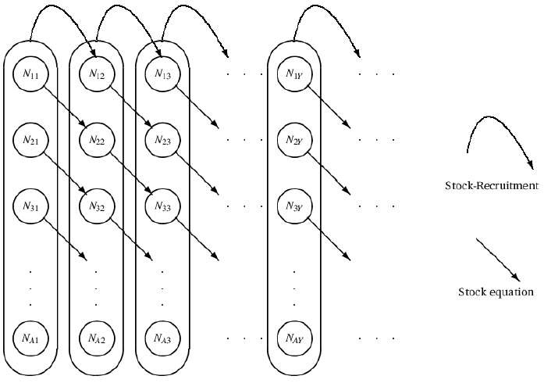
Age-structured models
Statistical catch-at-age
Estimate initial numbers and forward-calculate
Alternative: Virtual population analysis (VPA)
Estimate current numbers and back-calculate
Can account for processes occurring by age, not just the exploited population

Slide 3
Statistical catch-at-age (SCA) example 1
Estimating:
Numbers-at-age in the first year
Recruits (numbers age-0)
Fully-selected fishing mortality by year
Age at 50% and 95% selectivity
Catchability
Specifying:
Natural mortality
Weight-at-age
Weights for the catch, CPUE, and catch-at-age data
Process and observation error
Fitting to:
Catch, CPUE, and catch-at-age data
Variability (process error)
Measurement error (observation error)
Parameters
Statistical criterion
State dynamics model
Observation model
(Predicted data)
Observations (Data)

Slide 4
SCA example 1: Data
Create new .TPL “AS1.tpl”
Fill in DATA_SECTION to match AS1.dat
Test that DATA_SECTION read in correctly

Slide 5
SCA example 1: Parameters
Fill in PARAMETER_SECTION to match AS1.pin
Set up derived quantities:
N: abundance over time (rows) and ages (columns)
S: Selectivity-at-age
F: Fishing mortality over time (rows) and ages (columns)
Z: Total mortality over time (rows) and ages (columns)
Catch_pred: predicted catch over time
CPUE_pred: predicted CPUE over time
Propn_pred: predicted catch-at-age over time and age
Bio: Vulnerable biomass over time
NLL1, NLL2, and NLL3 – for each of the objn components
Test that PARAMETER_SECTION read in correctly

Slide 6
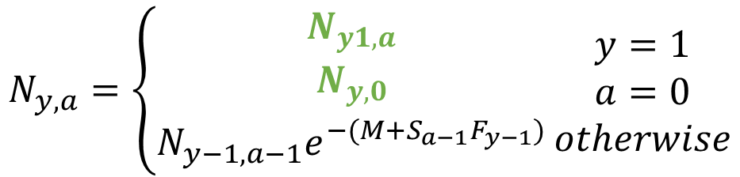
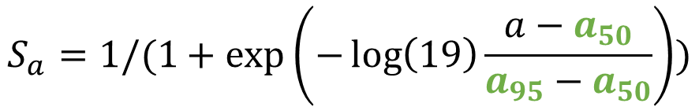

SCA example 1: Population dynamics
FUNCTIONS
Selectivity
Numbers
Predict_Observations
$$S_{a}=1/(1+\exp\left(−\log\left(19\right)\frac{a−a_{50}}{a_{95}−a_{50}}\right))$$
$$N_{y,a}=\left\{\begin{matrix}N_{y1,a} \\ N_{y,0} \\ N_{y−1,a−1}e^{−(M+S_{a−1}F_{y−1})}\end{matrix}\right.\begin{matrix}y=1 \\ a=0 \\ otherwise\end{matrix}$$
$$P_{y,a}=\frac{F_{y}S_{a}}{M+F_{y}S_{a}}N_{y,a}\left(1−\exp\left(−M−F_{y}S_{a}\right)\right)$$
$$C_{y}=\sum{W_{a}P_{y,a}}$$
$${CPUE}_{y}=qB_{y}$$

Slide 7
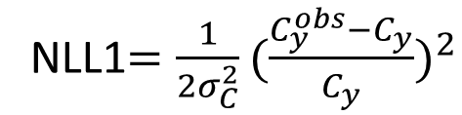

SCA example 1: Likelihood
FUNCTIONS
4) Likelihood
Catch (Normal) Catch-at-age (Multinomial)
CPUE (Lognormal)
NLL1$=\frac{1}{2σ_{C}^{2}}{(\frac{C_{y}^{obs}−C_{y}}{C_{y}})}^{2}$
NLL3$=−ω\sum_{y}{\sum_{a}{P_{y,a}^{obs}log⁡(P_{y,a}}/}$ $P_{y,a}^{obs}$)
NLL2$=\frac{1}{2σ_{q}^{2}}\sum_{y}{{(\log\left({CPUE}_{y}^{obs}\right)−\log\left({CPUE}_{y}\right))}^{2}}$

Slide 8
Exercises
The model currently assumes the last age group consists of fish only age-12, when in reality it is age-12 and above. Create a plus group for the last age:
Catches of fish in the first age group are largely from discard estimates. Extend the model to use a separate variance for catches of fish in the first age group.
Extend the model to use one set of catchabilities for the first ten years, and a different set in the last 10 years.
$$N_{A,t}=N_{A−1,t−1}e^{−Z_{A−1,t−1}}+N_{A,t−1}e^{−Z_{A,t−1}}$$

Slide 9
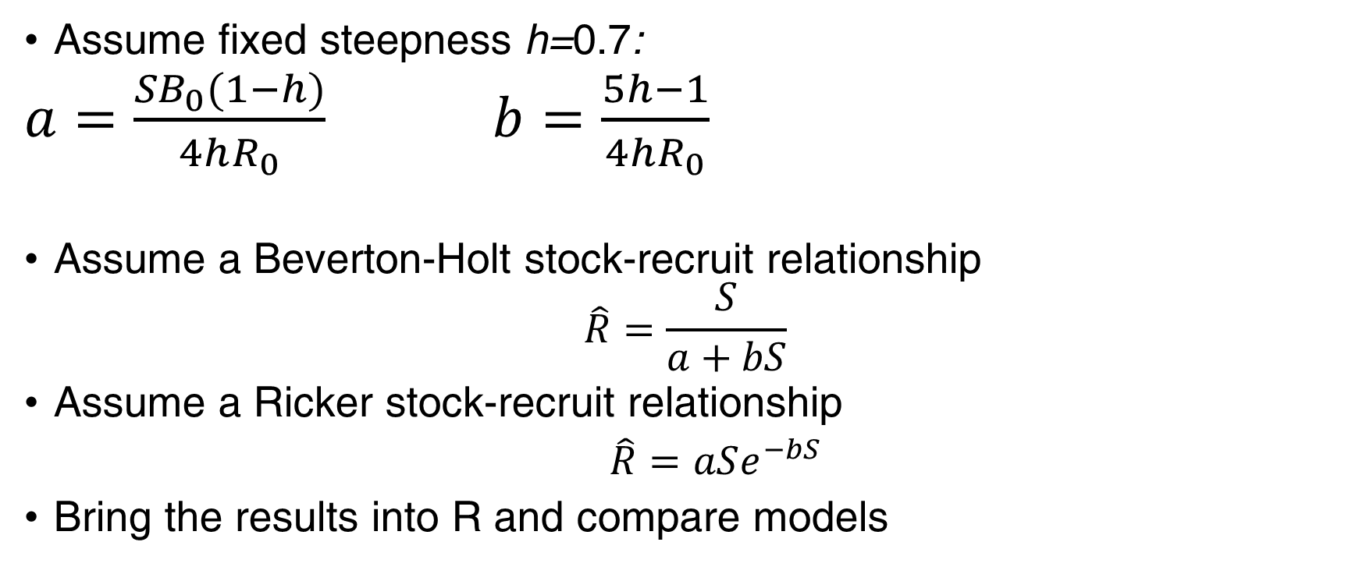
fsa: Add a stock-recruit relationship
Assume fixed steepness h=0.7:
$a=\frac{{SB}_{0}(1−h)}{4hR_{0}}$ $b=\frac{5h−1}{4hR_{0}}$
Assume a Beverton-Holt stock-recruit relationship
$$\hat{R}=\frac{S}{a+bS}$$
Assume a Ricker stock-recruit relationship
$\hat{R}=aSe^{−bS}$
Bring the results into R and compare models

